Slide 1
WDR81-WDR91 in Infection of SARS-CoV-2
School of Pharmacy
University College London
Kangping Liu
Prof. Matthew H. Todd Group

Slide 2
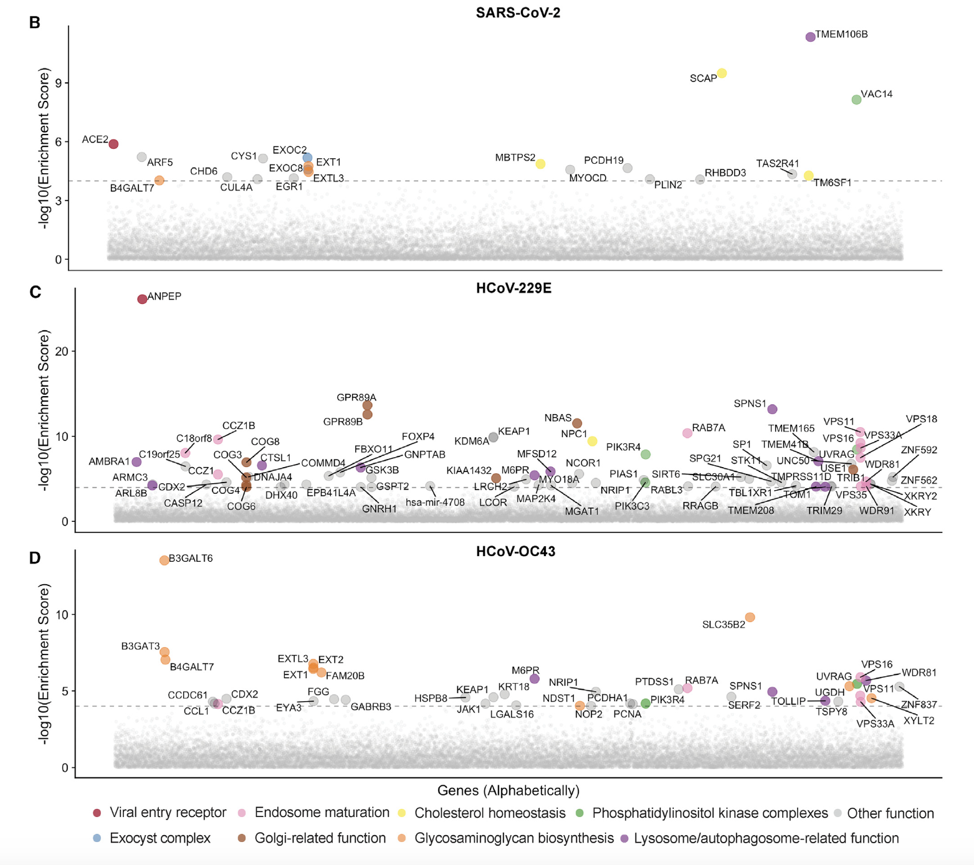
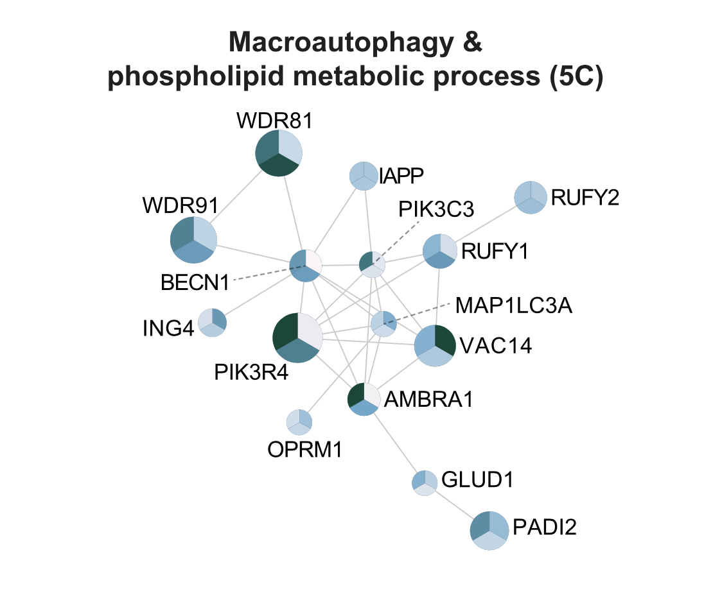
School of Pharmacy
University College London
Wang et al., 2021
Notes:
LHS:gene screen related to infection of SARS-CoV-2, 229E and OC43. Relevance between infection of SARS-CoV-2 and WDR81 may not be clear
RHS:Network of neighborhoods across all 3 species and shows WDR81 and WDR91 may work in pair.

Slide 3
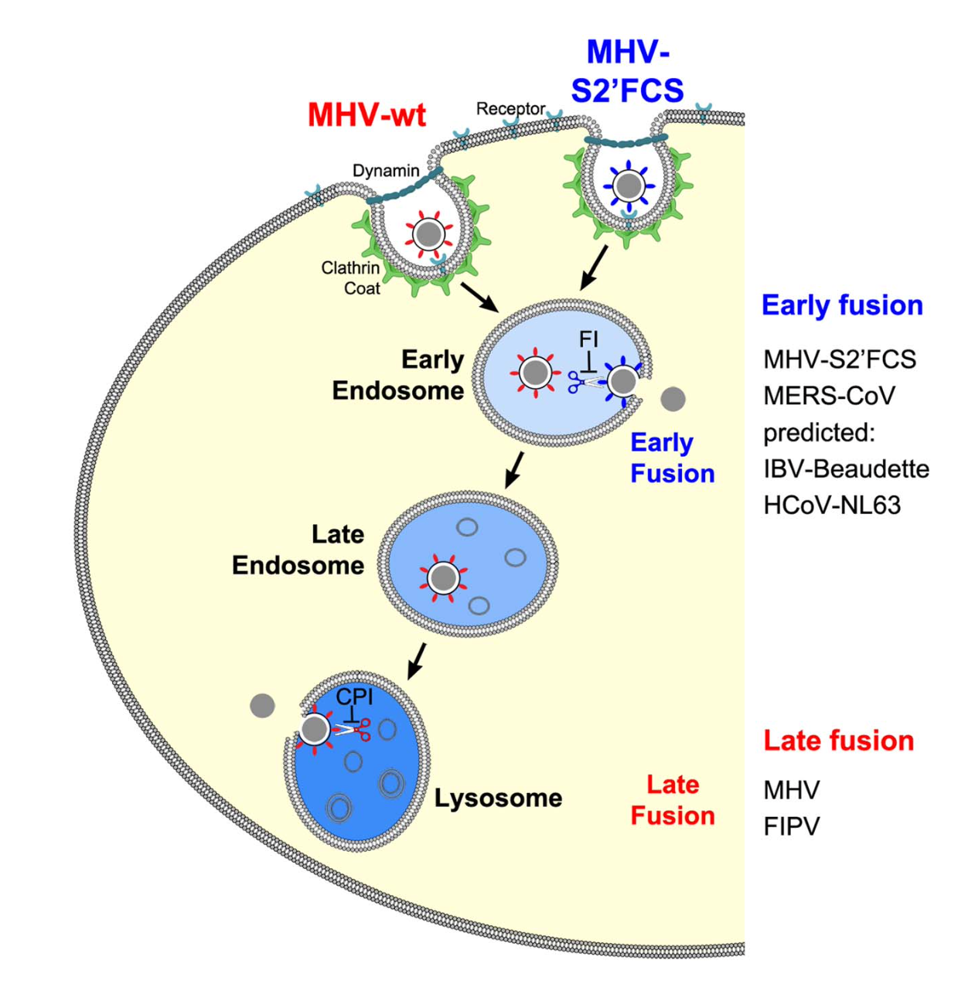
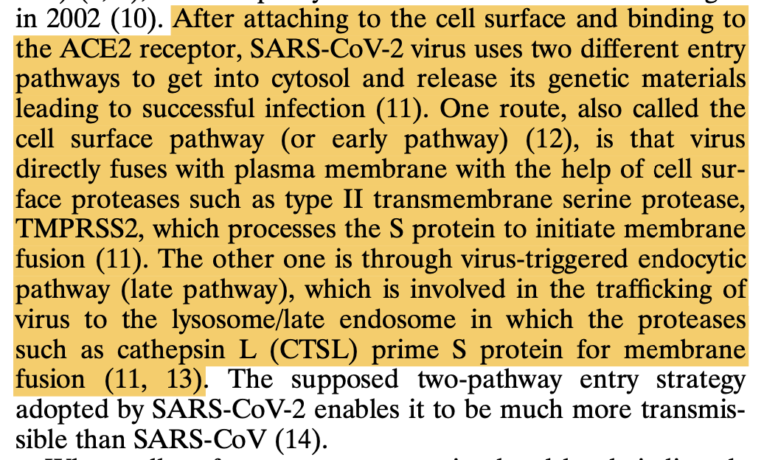
School of Pharmacy
University College London
WDR81-WDR91 involved
Scheme: Burkard et al., 2014
Text: Yang et al., 2022
Notes:
LHS:WDR81-WDR91 act in the red arrow stage
RHS:SARS-CoV-2 enter the cell via 2 pathways---which one it will take in infection of human or in particular-–human lung cells?

Slide 4
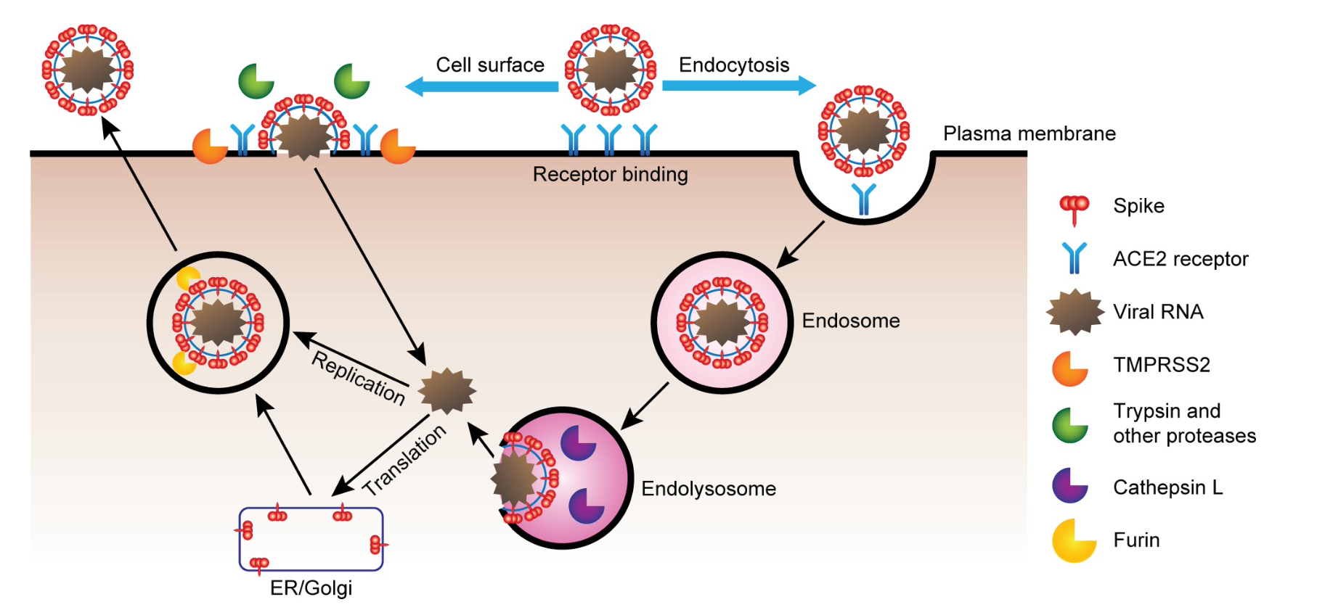
School of Pharmacy
University College London
Murgolo et al., 2021

Slide 5
School of Pharmacy
University College London
Camostat mesylate
Cathepsin B/L
E-64d
Hoffmann et al. 2020

Slide 6
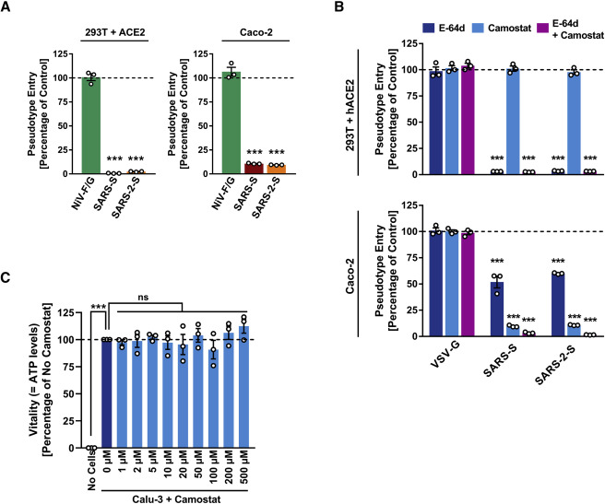
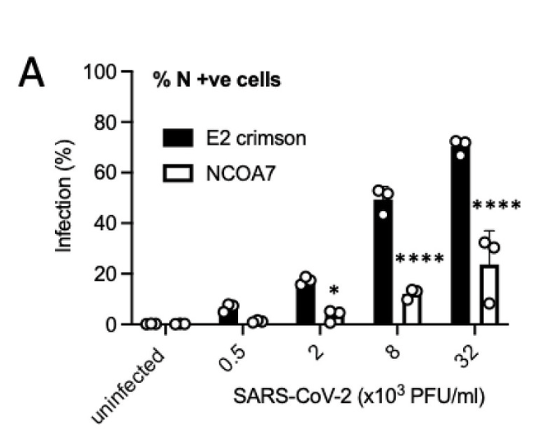
School of Pharmacy
University College London
Hoffmann et al. 2020
Khan et al., 2021
Notes:
LHS: direct entry inhibited by camostat. Endo-lysosomal pathway is present in Caco-2 (human colon cell).No infection in cells whose endo-lysosomal pathway is shun down by E-64d.
RHS: Endo-lysosomal pathway inhibited by NCOA7, E2 crimson as control group in A549 cells.
Endo-lysosomal pathway confirmed in infection of SARS-CoV-2 in human lung cells

Slide 7
School of Pharmacy
University College London
Endo-Lysosome pathway confirmed in Huh7, Caco-2 & A549 cells
Infection of SARS-CoV-2 can potentially prevented by inhibiting the WDR81-WDR91

